Slide 1

Data Visualization with Python

Slide 2
Objectives
Apply the knowledge learned to perform statistical analysis of data
Represent statistical data in the form of visualization
Implement by Python language
Lab - Data Visualization

Slide 3
Requirements
You are required to create a Choropleth map to visualize crime in San Francisco.
Dataset: https://cocl.us/sanfran_crime_dataset
JSON file: https://cocl.us/sanfran_geojson.
Lab - Data Visualization

Slide 4
Tasks
Task 1: represents the total number of crimes in each neighborhood.
Task 2: creating the Choropleth map.
Lab - Data Visualization

Slide 5
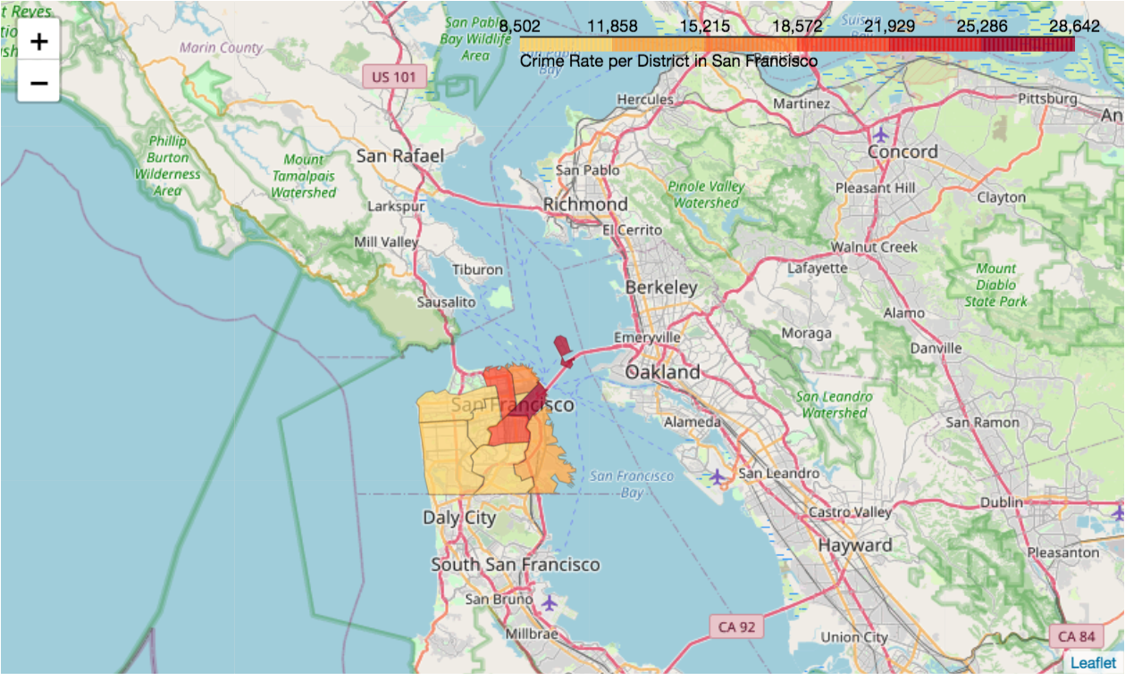
Expected Result - Task 2
Lab - Data Visualization

Slide 6
Summary
Apply the knowledge learned to perform statistical analysis of data
Represent statistical data in the form of visualization
Implement by Python language
Lab - Data Visualization

Slide 7
Q & A
Lab - Data Visualization

